Slide 1



Research
Historical Studies
4N3306

Slide 2
Research is asking a question and finding an answer
It is looking into something
Looking for something
Comparing and contrasting things
Finding out more information
Counting things
Making enquiries
Being curious
Finding out what people think, do and want
Finding out what works and what doesn’t work

Slide 3
Research gives us information about
Thoughts and opinions
Events
People
Attitudes
Culture

Slide 4

Primary Source
A Primary Source is one that comes directly from the time being studied
Examples of Primary Sources are diaries, autobiographies and artefacts

Slide 5

Secondary Source
A secondary source is one that is written or made after the events being studied and by someone who did not witness the events first hand
Examples of Secondary Sources are textbooks and biographies

Slide 6
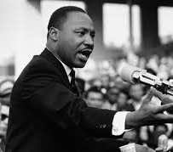
Primary or Secondary?
Martin Luther King’s ‘I have a dream’ speech

Slide 7

Primary or Secondary?
An encyclopaedia

Slide 8

Primary or Secondary?
History book about Ireland written in 2005

Slide 9

Primary or Secondary?
The diary of Anne Frank

Slide 10
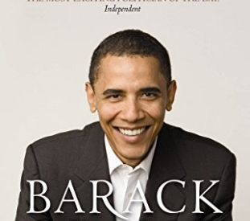
Primary or Secondary?
Barack Obama’s autobiography

Slide 11
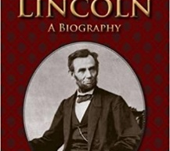
Primary or Secondary?
A biography of Abraham Lincoln written by Benjamin P. Thomas

Slide 12

Quiz Time

Slide 13
Questions
On what dates did the 1916 rising start and end?
What was the aim of the rising?
What were the causes of the 1916 rising?
What buildings were taken over during the 1916 rising?
Why did the 1916 rising start a day later than planned?
What groups took part in the rising on both the Irish and British sides?
How many people died during the rising?
What does the 1916 proclamation say?
How did the 1916 rising end?
What were the lasting effects of the 1916 rising?

